Slide 1
Change in Perspective in Mathematics Education
Michael Nguyen

Slide 2
Why is learning mathematics important?
Socrative.com
Room: Jehue1
Notes:
Have parents jot down some thoughts and share with the group.

Slide 3
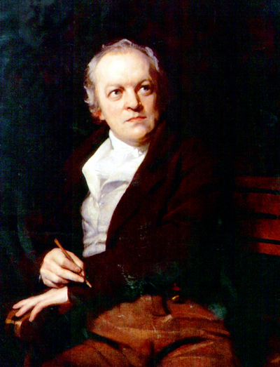
William Blake (1757-1827)
"To see a World in a Grain of Sand,
And a Heaven in a Wild Flower,
Hold Infinity in the palm of your hand,
And Eternity in an hour."

Slide 4
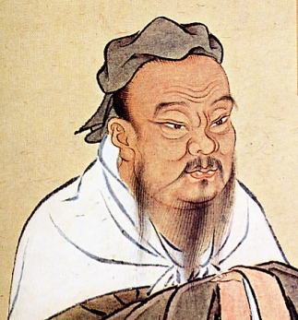
“I hear and I forget.
I see and I remember.
I do and I understand.”
Confucius

Slide 5
The skills of Mathematics:
Mathematics provide us with skills to solve problems:
Re-arrange (1+2+3+4+5+6+7+8+9)
Ignore (trivial information)
Add (assumptions and parameters)
Change Perspective
Mathematics force us to develop essential habits:
Visualizer
Experimenter
Inventor
Describer
Investigator

Slide 6
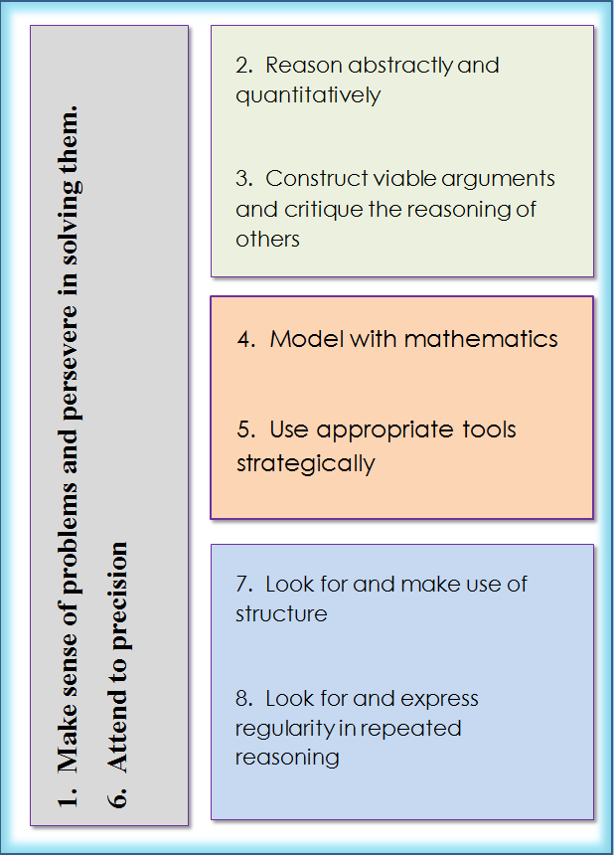
Notes:
Discuss the Mathematical Practices and pass out to parents. Ask parents to hang these mini posters in their child’s room.

Slide 7
What can you do to help your student do well in the Common Core Math classroom?
Notes:
Give parents some time to think about an answer.

Slide 8
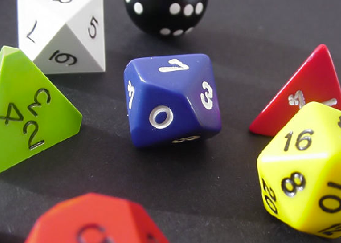
The Intricacies of Numbers
Notes:
Simply doing is not enough…students need to know what they are doing and why it works.

Slide 9
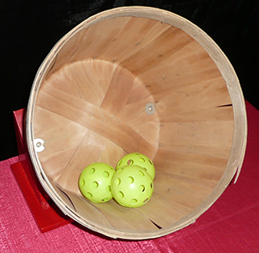
Carnival Game
Notes:
Challenge the students to think about the concept of fairness. Is it fair? Is it not fair? Why or why not?

Slide 10
Does it make sense?
Is it reasonable?
Notes:
Have parents think up of something that can be graphed.

Slide 11
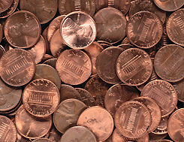
The Penny Problem
If you were given a choice to receive one million dollars in one month or a penny doubled every day for 30 days [the amount on the 30th day] which one would you choose? Why?
Notes:
It’s not a matter of which has more money…but rather, which choice would they make and why?

Slide 12
Would your answer be different if the amount was 5 million dollars?

Slide 13
Linear vs Exponential Growth
What would you like to grow linearly?
What would you like to grow exponentially?

Slide 14
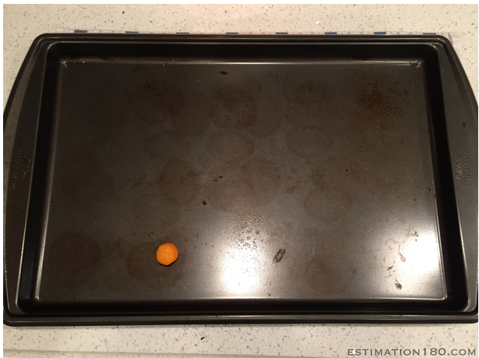
How many cheeseballs will fit in the tray?
Notes:
Math is an art…an art of estimation.

Slide 15
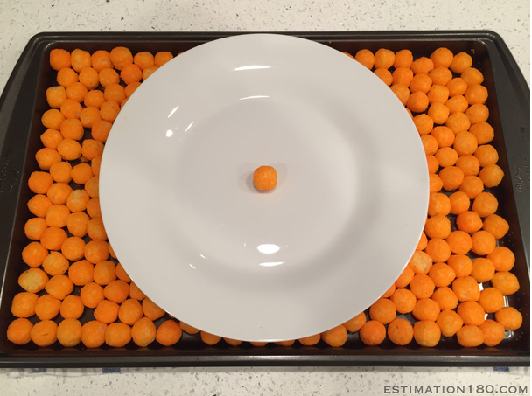
How many cheeseballs will fit on the large plate?

Slide 16
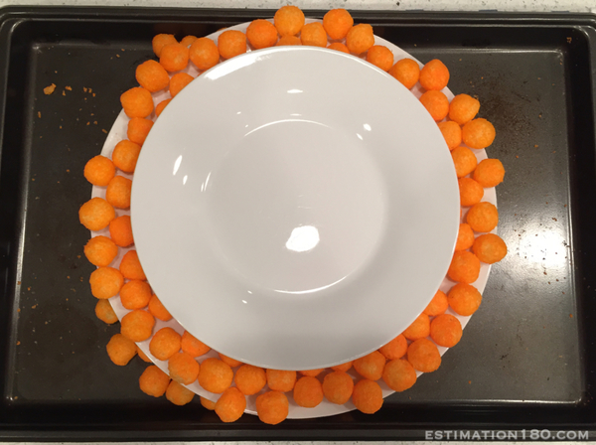
How many cheeseballs will fit on the smaller plate?

Slide 17
What is Mathematics?
A science of pattern
An Art
An embodiment of paradoxes
A way of life!!!

Slide 18
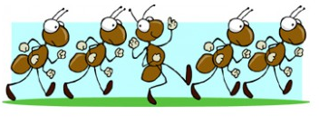
Marching Ants
100 ants are randomly dropped on a meter stick. The ants either travel left or right at the rate of 1 meter/min. If the ants bump into each other, they immediately turn around and travel in the opposite direction without loss of speed or time.
What is the least amount of time it would take for the ants to all walk off the meter stick?
What is the greatest amount of time it would take for the ants to all walk off the meter stick?

Slide 19
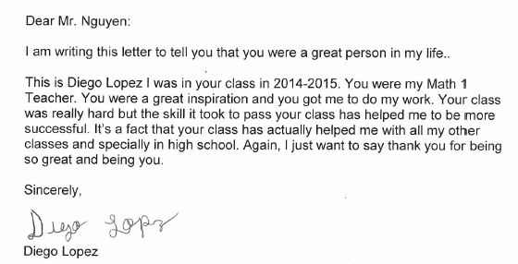
Letter from a student

Slide 20
Thank you for attending the workshop.
As a parting gift, I challenge you to formulate an answer to:
“Why is learning math important?”
And
“How do we know that they are learning?”

