Slide 1
Welcome!!
Notes:
Have this displayed as people enter the room.

Slide 2
Welcome!!
The purpose for this dinner is to find the best ways for RSBCMTA to serve our community of mathematics educators. We value the insights of you, our friends.
Notes:
Have this displayed during dinner.

Slide 3
CMC Mission Statement
The California Mathematics Council (CMC) believes that all students have the capacity to become mathematically competent and confident when provided a rigorous and challenging mathematical program supported by high expectations
Notes:
Our history and purpose begins with our relationship with CMC.

Slide 4
RSBCMTA Purpose
http://rsbcmta.weebly.com/membership.html
Constitution Section 3
The purpose of the organization shall be:
a) To promote effective teaching of mathematics at all levels
b) To promote productive disposition toward mathematics by all
c) To inform members of programs and resources available
To build community and create networking opportunities for teachers of mathematics In the region
e) To facilitate discussion and exchange of research, information and ideas.
f) To support communication between mathematics teachers, administrators and the
public
g) To cooperate with various national, state, and local organizations who share our
common goals
h) To recognize excellence in the teaching of mathematics
i) To promote the philosophy of the California Mathematics Council
Notes:
Our intended purpose as expressed in our Constitution.

Slide 5
2012 – 2013
Tuesday, May 7, 2013, 4:00 – 7:30 p.m., SBCSS Brier Building
Input on Draft Framework
Various Facilitators
Tuesday, March 12, 2013, 5:30 – 7:30 p.m., RCOE Riverside
MDTP for CAHSEE Preparatory Diagnostic and Related Common Core
Dr. John Sarli, CSUSB Site Director for MDTP
Tuesday, January 22, 2013, 5:30 – 7:30 p.m., Chavez/Huerta Center for Education, Rialto USD
Elementary and Secondary Tasks to Support the CCSS
Dr. Melanie Maxwell, Riverside USD, and Bruce Grip, Chaffey, Joint Union HSD
Tuesday, October 22, 2012, 5:30 – 7:30 p.m., RCOE Riverside
Transitioning to the Common Core State Standards
Kevin Phillippi and Christa Wallis, San Bernardino City Schools
Notes:
Tuesday meetings that followed the network meetings. Typical attendance about 20-30 people.

Slide 6
2013 – 2014
Tuesday, May 13, 2014, 5:30 – 7:30 p.m., Citrus Valley HS
The Best Websites for Math Teachers
Mary Vongsavanh, Murrieta Valley USD
Tuesday, March 18, 2014, 5:30 – 7:30 p.m., RCOE Riverside
Using Transformations to Understand the Common Core Transformation Geometry
Jennifer Hagman, Independent Consultant
Tuesday, January 28, 2014, 5:30 – 7:30 p.m., Chavez/Huerta Center for Education, Rialto USD
Understanding the CCSS Using the Framework as a Resource
Dr. Ed d’Souza, Senior Director, Rialto USD
Tuesday, October 23, 2013, 5:30 – 7:30 p.m., RCOE Riverside
Using Progressions to Understand the Common Core Fraction Standards
Jennifer Hagman, Independent Consultant
Notes:
Jenny did two sessions on progressions. Jenny is a “local leader.”

Slide 7
2014 – 2015
Tuesday, May 19, 2015, 5:30 – 7:30 p.m., RCOE Indio
Exploring the California Digital Library Resources (Repeat of March 17)
Annette Kitagawa, RCOE
Tuesday, May 12, 2015, 5:30 – 7:30 p.m., SBCSS San Bernardino NO SHOWS/CANCELED
Supporting a Growth Mindset in the Math Classroom
Jeff Burke, SBCSS
Tuesday, March 17, 2015, 5:30 – 7:30 p.m., RCOE Riverside
Exploring the California Smarter Balanced Digital Library
Diana Ceja, RCOE
Tuesday, January 27, 2015, 5:30 – 7:30 p.m., SBCSS San Bernardino
Bringing Parents Into the Mathematics Learning Community
Kelli Wasserman, Independent Consultant
Tuesday, October 21, 2014, 5:30 – 7:30 p.m., RCOE Riverside
Modeling With Mathematics to Promote Better Problem Solvers (4-12)
Michelle Appleby, Hilda Castillo, Min Ku, Ontario-Montclair School District
Notes:
Variety of relevant topics. Local leaders and county office persons.

Slide 8
2015 – 2016
In March we attempted a repeat meeting two days apart with one at Grand Terrace HS and the other at RCOE Murrieta. We did not have any meetings at SBCSS Roy C. Hill
Tuesday, May 3, 2016, 5:30 – 7:30 p.m., RCOE Riverside
Games, Games, Games
Various Presenters
Tuesday, March 15, 5:30 – 7:30 p.m., Grand Terrace HS
Thursday, March 17, 4:30 – 6:30 p.m., RCOE Murrieta
Math Talks and Number Talks
Andrea Cadman, Lori McNeil and Chris Shore, Temecula Valley USD
Mary Vongsavanh, Murrieta Valley USD
Thursday, January 21, 2016, 5:30 – 7:30 p.m., Grand Terrace HS
Using Simple Questions to Promote Higher Order Thinking
Michael Nguyen, Rialto USD
Tuesday, October 13, 2015, 5:30 – 7:30 p.m. RCOE Riverside
Bringing Parents Into the Mathematics Learning Community (Repeat/Revised)
Kelli Wasserman, Independent Consultant
Notes:
Definitely local leaders.

Slide 9
2016 – 2017
Several modifications were made this year. We separated from the County Network meetings so we could begin and end earlier. We moved to Monday nights. We instituted a 2 for 1 promotion. Much of the content was elementary and middle school focus.
Monday, April 24, 2017, 4:30 – 6:30 p.m., RCOE Murrieta
The Learning Carpet and Clothesline Math
Adriann Huntington and Sherese Ferrell, Murrieta Valley USD
Kelli Wise, Temecula Valley USD
Monday, March 13, 2017, 4:30 – 6:30 p.m., SBCSS Rancho Cucamonga CANCELLED
Hands-On Math
Denise Dodge and Sabrina Blake, Ontario-Montclair SD
Monday, January 30, 2017, 4:30 – 6:30 p.m., Grand Terrace HS
Getting All Students Engaged in Mathematical Discourse
Karon Woolsey, Instructional Coach, Redlands USD
Tuesday, October 4, 2016, 4:30 – 6:30 p.m., RCOE Riverside
Drawing Mathematical Reasoning From Card Games: Classroom Edition
Dr. Jeremy Aikin, CSUSB
Notes:
More local leaders. Switched to Monday’s and earlier time.

Slide 10
California Mathematics Council
Affiliate Activities
Greater San Diego Mathematics Council (GSDMC)
www.gsdmc.org
Friday, January 20, 2017, 8:00 a.m. – 3:15 p.m. Cost: $75
Opening (Vaudrey/Kaplinsky/Hakansson/Stadel + Three Sessions + Boxed Lunch

Slide 11
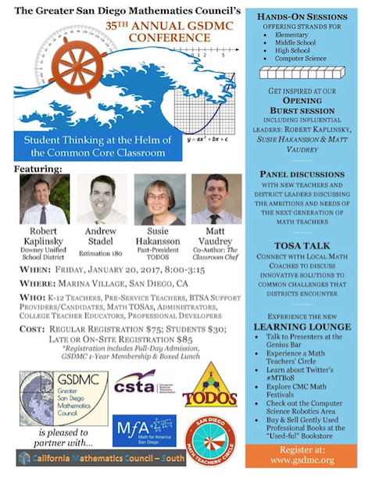

Slide 12
California Mathematics Council
Affiliate Activities
Greater San Diego Mathematics Council (GSDMC)
www.gsdmc.org
Friday, January 20, 2017, 8:00 a.m. – 3:15 p.m. Cost: $75
Opening (Vaudrey/Kaplinsky/Hakansson/Stadel + Three Sessions + Boxed Lunch
Ventura County Mathematics Council (VCMC)
www.vcmc.org
Thursday, March 16, 2017, 4:00 – 6:30 p.m. Cost: $15
Overview + Grade Level Breakouts

Slide 13
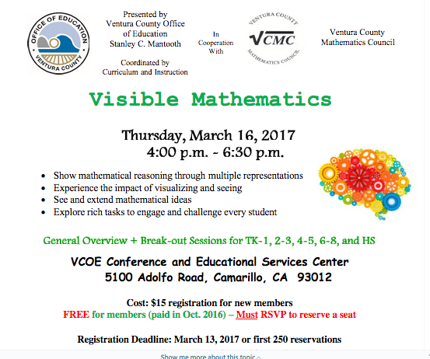

Slide 14
California Mathematics Council
Affiliate Activities
Orange County Mathematics Council (OCMC)
www.ocmathcouncil.com
Monday, October 17, 2016: 4:30 – 8:00 p.m. Cost: $20
Monday, February 27, 2017, 4:30 – 8:00 p.m. Cost: $20
Keynote (Vaudrey) + Boxed Dinner + Two Breakout Sessions + Raffle

Slide 15
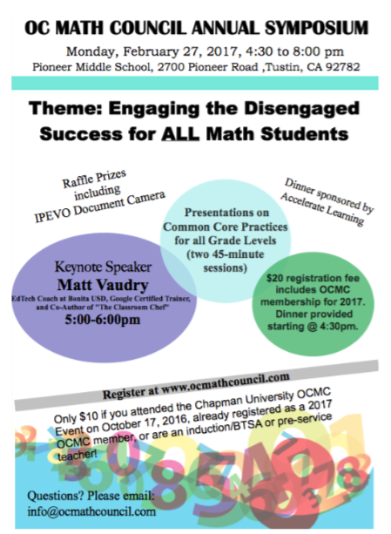

Slide 16
California Mathematics Council
Affiliate Activities
Orange County Mathematics Council (OCMC)
www.ocmathcouncil.com
Monday, October 17, 2016: 4:30 – 8:00 p.m. Cost: $20
Monday, February 27, 2017, 4:30 – 8:00 p.m. Cost: $20
Keynote (Vaudrey) + Boxed Dinner + Two Breakout Sessions + Raffle
Region X MaTHink 2017
http://rsbcmta.weebly.com/mathink-2017.html
Saturday, February 25, 2017, 8:30 a.m. – 2:15 p.m. Cost: $30
Three Sessions + Boxed Lunch + Raffle

Slide 17
We are looking for your input and ideas on (from invitation):
What timeframe for meetings works best for educators
What type of meeting is best
Topics of interest or need in your area
The best ways to communicate these opportunities to educators
in your area

Slide 18
What should we do? Not do? (compete, duplicate)
- Advantage of non-profit and CMC Affiliate relationship
- Dinner Meetings
• Continue or not?
• Day of the week
• Time
• Grade levels (alternate/concurrent/general audience)
• Topics
• Location(s)
• Networking/Presentation/Sharing/Blend
- Saturday Events
• February MaTHink
• September
- Partnerships
• CSUSB
• UCR
• University of Redlands
- What are we missing that we could be doing?
• “I wish someone would….

Slide 19
Possible Involvement
- At-large Board member
• 5 Board Meetings • Four Dinner Meetings • MaTHink
- Committee chair or committee member
• Membership (Karen)
• Communication • Newsletter • Website (Bruce)
• Student Activities
• Awards (Kelli)
• Constitution and Bylaws and Affiliation

Slide 20
- Event Planner
• Dinner Meeting
- Network activity (opener)
- Food and drink
- Registration
- Presenter (Featuring Local)
• Conference Committee
- MaTHink
- September?
Communication
• Twitter/Facebook

Slide 21
• Be part of the planning committee for one meeting during the year
• Be part of a distribution system that gets the message out to as many people as
possible
• Advertise our meetings on their blogs, websites, Twitter, Facebook, school or
district calendar
• Be a member of a committee (Outstanding Teacher Award, Student Activities)
• Take on a specific support role: Membership, Calendar
• Serve as an at-large Board member (5 Board Meetings per year)
• Provide the drinks for the meetings
• Arrange for the food for the meetings
• Do a presentation at one of the meetings or co-present
Learning From Local Leaders

